Slide 1
Human(s)
Computing Device
Map
A
B
C
User-Centered
Technology-Centered
Interfaced-Centered

Slide 2
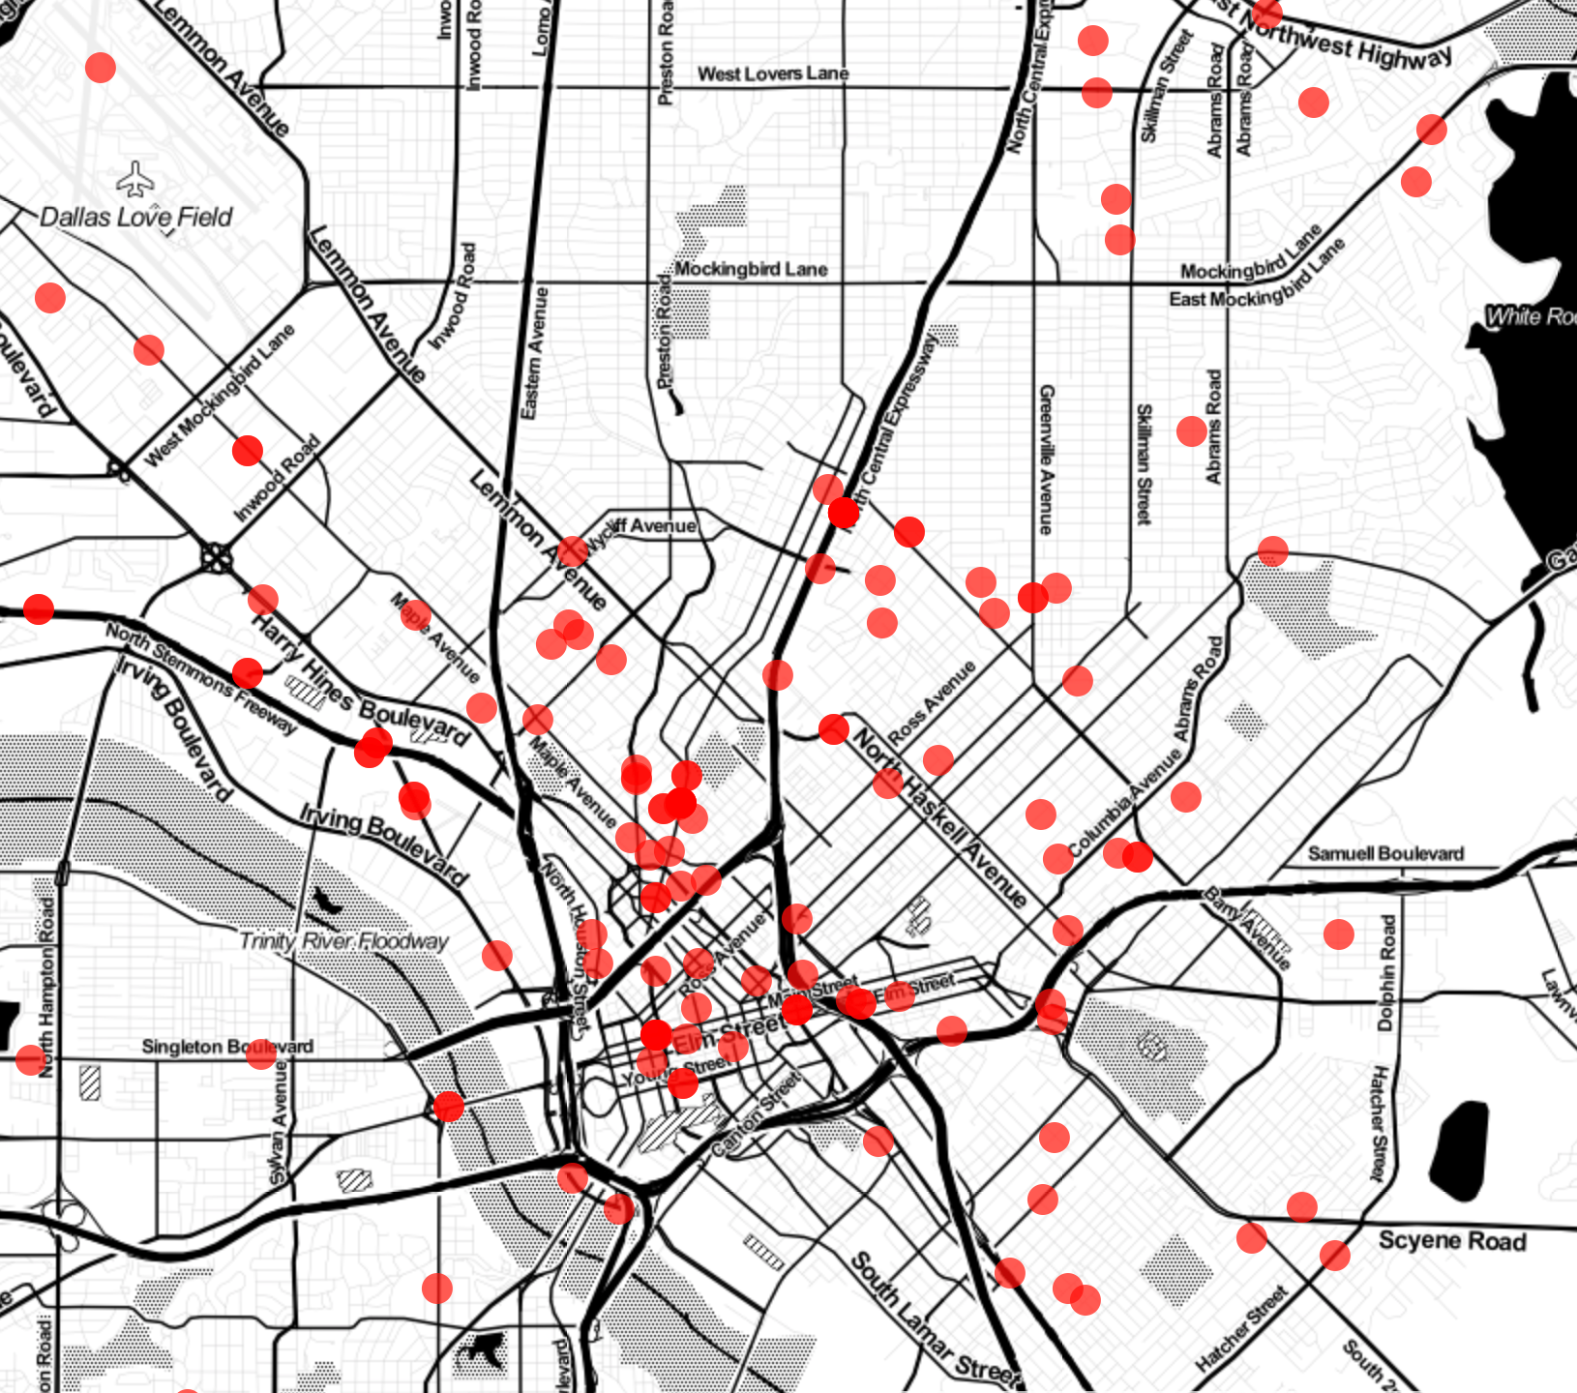
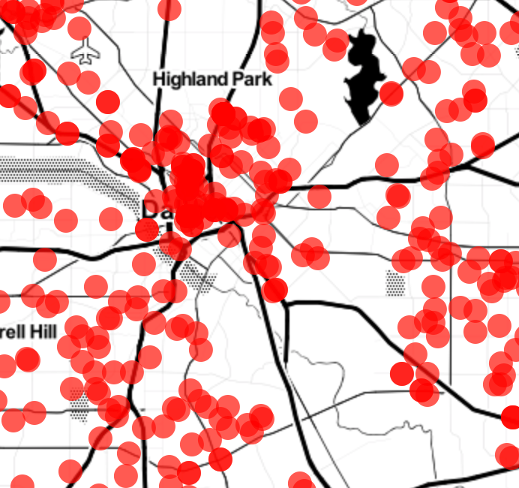
Un-Zoomed
User Zoomed

Slide 3
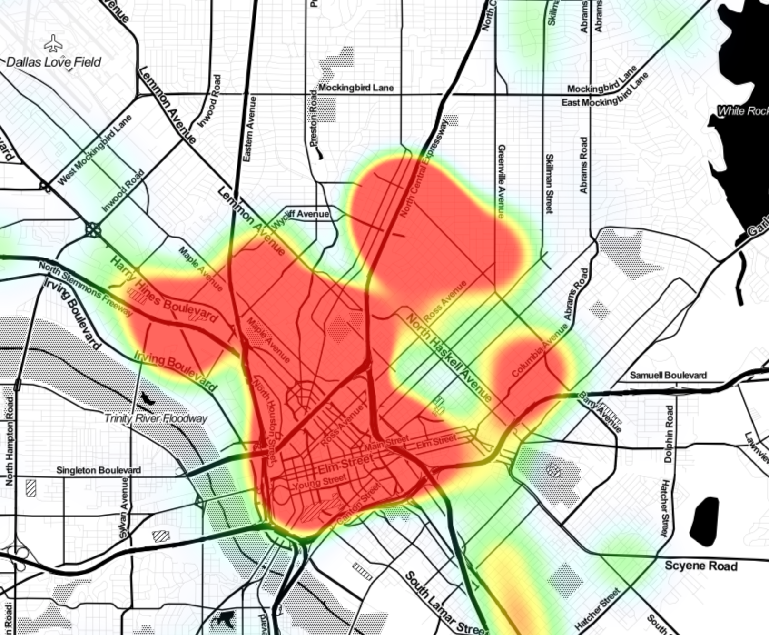
Heat Map
Dot Map

Slide 4
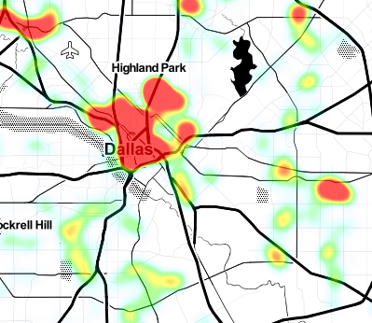
Un-Zoomed
User Zoomed

Slide 5
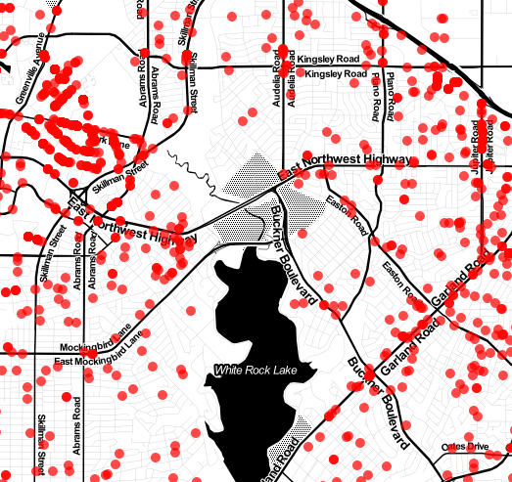
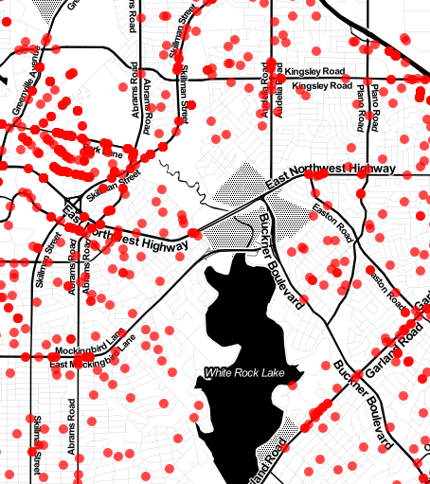
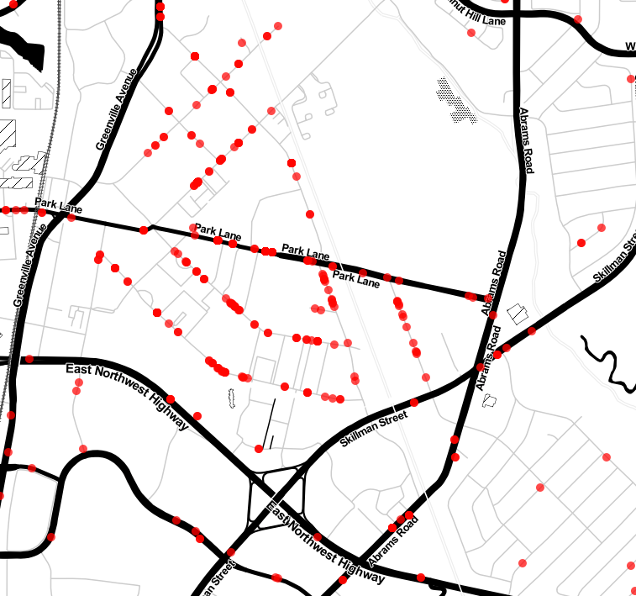
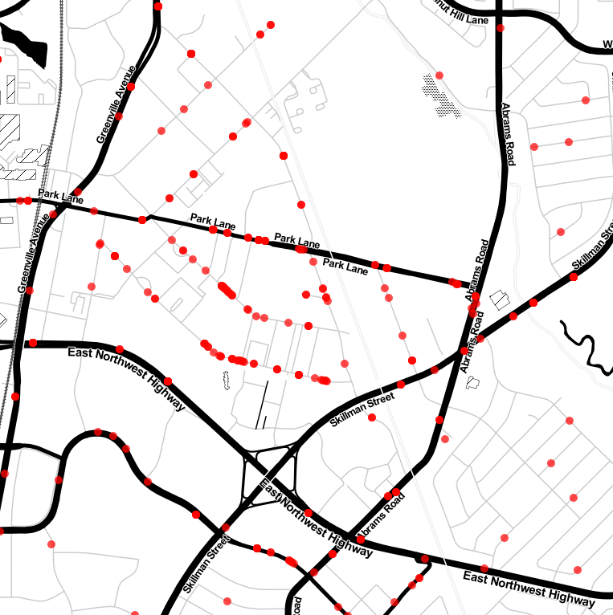
2016
2017
2016
Zoomed
2017
Zoomed

Slide 6
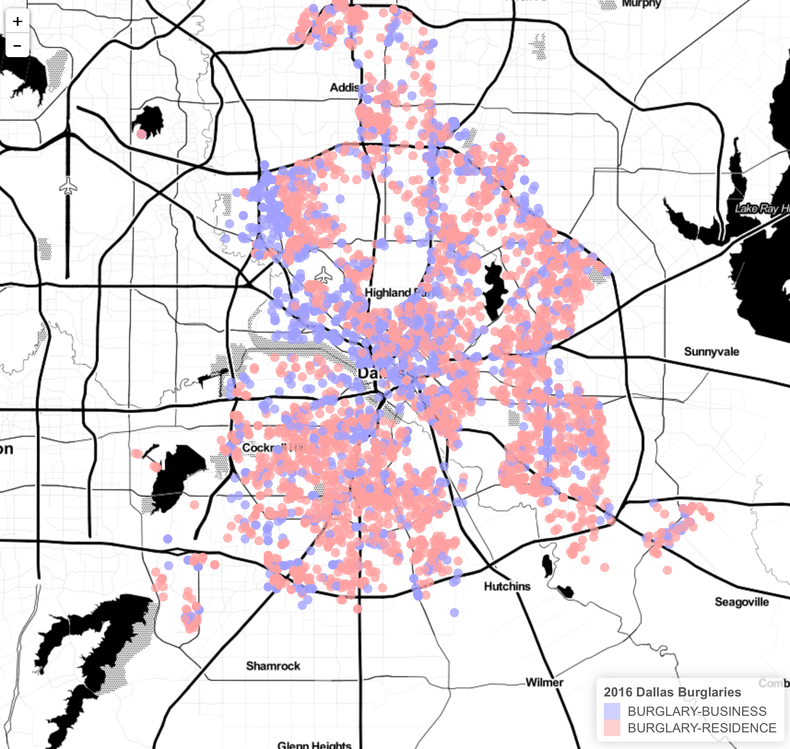

2016
2017

Slide 7
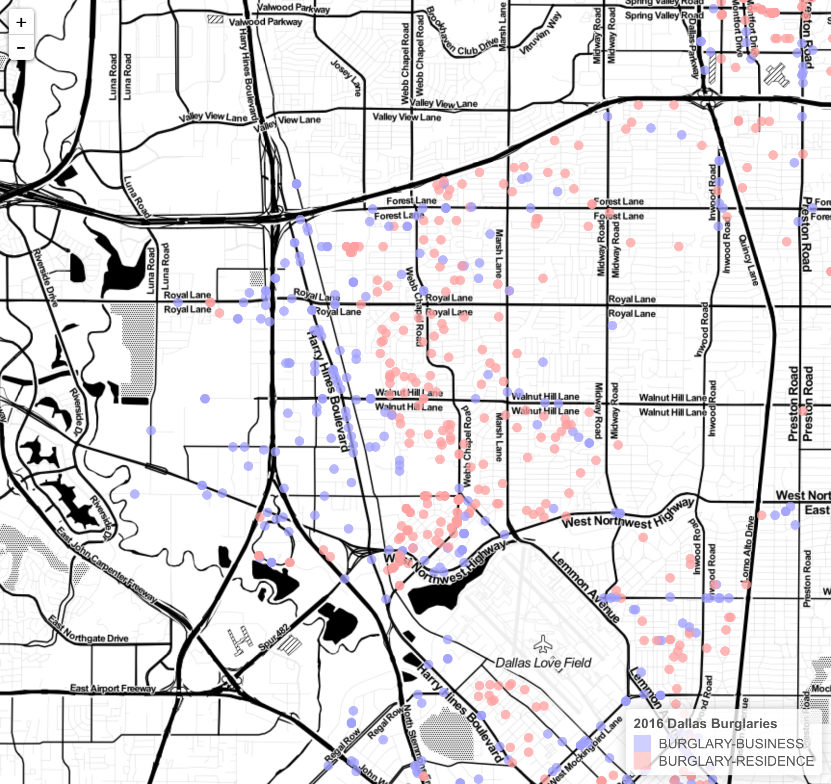
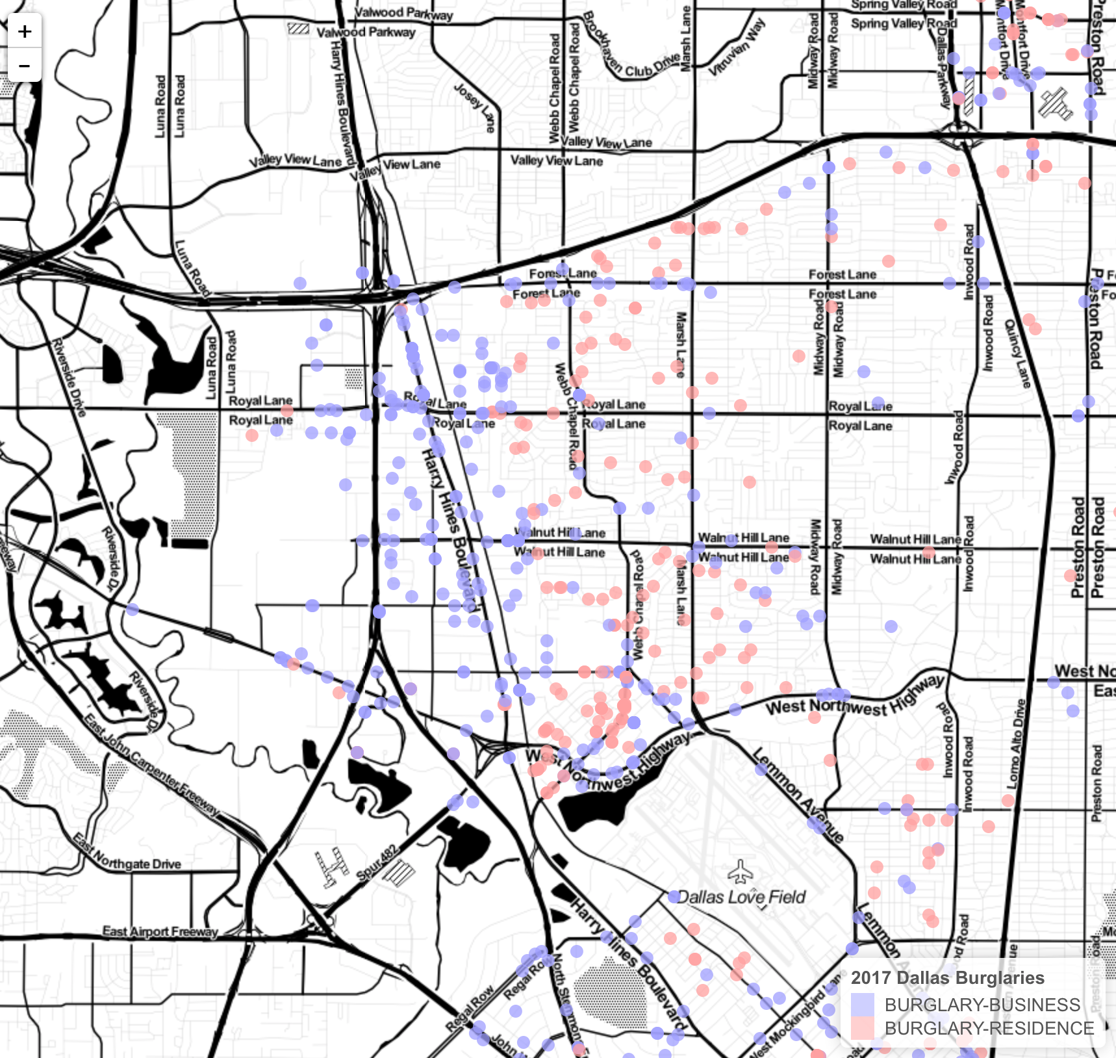
2016
2017

